Slide 1
Private API and Frameworks
Sem Voigtländer

Slide 2
Index
Introduction
Reverse engineering
Reconstructing
Security flaws
Conclusion and solution

Slide 3
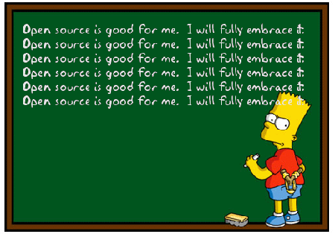
Introduction
Undocumented
Not opensource
Usage
Obscurity
Benefits

Slide 4
Reverse engineering
MACH-O Header
Symbol table
Private / Public properties
Enumeration
Interpositioning

Slide 5
Reconstructing
NSBundle / dlopen
NSClassFromString / dlsym
Dictionaries and properties
Selectors
Header files

Slide 6

Security flaws
Path traversal
Privilege escallation
Information Disclosure!!!
TOCTTOU

Slide 7

Conclusion
Tinker, Tailor, Spy
PoC Demo

Slide 8

Solution
Entitlement enforcement by CA via codesigning
Symbol obfuscation
Improved sandboxing
Predefined loading of frameworks?

Slide 9
Solution
Entitlement enforcement by CA via codesigning
Symbol obfuscation
Improved sandboxing
Predefined loading of frameworks?

